Slide 1
CHAPTER Cost 10 Functions

Slide 2
Definitions of Costs
It is important to differentiate between accounting cost and economic cost
Accountants: out-of-pocket expenses, historical costs, depreciation, and other bookkeeping entries
Economists focus more on opportunity cost

Slide 3
Definitions of Costs
Labor Costs
Accountants: expenditures on labor are current expenses
Economists: labor is an explicit cost
Labor services (labor-hours) are contracted at an hourly wage (w)
It is assumed that this is also what the labor could earn in alternative employment

Slide 4
Definitions of Costs
Capital Costs
Accountants: use the historical price of the capital and apply some depreciation rule to determine current costs
Economists: refer to the capital’s original price as a “sunk cost”
Implicit cost of the capital - what someone else would be willing to pay for its use
We will use v to denote the rental rate for capital

Slide 5
Definitions of Costs
Costs of Entrepreneurial Services
Accountants: the owner of a firm is entitled to all profits
Revenues or losses left over after paying all input costs
Economists: the opportunity costs of time and funds that owners devote to the operation of their firms
Part of accounting profits would be considered as entrepreneurial costs by economists

Slide 6
Economic Cost
Economic cost of any input
The payment required to keep that input in its present employment
The remuneration the input would receive in its best alternative employment

Slide 7
Simplifying Assumptions
There are only two inputs
Homogeneous labor (l), measured in labor-hours
Homogeneous capital (k), measured in machine-hours
Entrepreneurial costs - included in capital costs
Inputs are hired in perfectly competitive markets
Firms are price takers in input markets

Slide 8
Economic Profits
Total costs for the firm: C = wl + vk
Total revenue for the firm: R = pq = pf(k,l)
Where p is the price
And the production function is q = f(k,l)
Economic profits (π): π = R - C
π = pq - wl - vk = pf(k,l) - wl - vk

Slide 9
Economic Profits
Economic profits
Are a function of the amount of k and l employed
We could examine how a firm would choose k and l to maximize profit
“Derived demand” theory of labor and capital inputs
Assume that the firm has already chosen its output level (q₀) and wants to minimize its costs

Slide 10
Cost-Minimizing Input Choices
Minimum cost
Occurs where the RTS = w/v
The rate at which k can be traded for l in the production process = the rate at which they can be traded in the marketplace

Slide 11
Cost-Minimizing Input Choices
Minimize total costs given q = f(k,l) = q₀
Setting up the Lagrangian:
ℒ = wl + vk + λ[q₀ - f(k,l)]
First-order conditions:
∂ℒ /∂l = w - λ(∂f/∂l) = 0
∂ℒ /∂k = v - λ(∂f/∂k) = 0
∂ℒ /∂λ = q₀ - f(k,l) = 0

Slide 12
Cost-Minimizing Input Choices
Dividing the first two conditions we get
The cost-minimizing firm should equate the RTS for the two inputs to the ratio of their prices

Slide 13
Cost-Minimizing Input Choices
Cross-multiplying, we get
For costs to be minimized, the marginal productivity per dollar spent should be the same for all inputs

Slide 14
Cost-Minimizing Input Choices
Useful reciprocal relationship:
The Lagrangian multiplier shows how the extra costs that would be incurred by increasing the output constraint slightly

Slide 15
10.1 Minimization of Costs of Reducing q₀
k per period
k^{c}
C₁
C₂
q₀
C₃
l^{c}
l per period
A firm is assumed to choose k and l to minimize total costs. The condition for this minimization is that the rate at which k and l can be traded technically (while keeping q = q₀) should be equal to the rate at which these inputs can be traded in the market. In other words, the RTS (of l for k) should be set equal to the price ratio w/v. This tangency is shown in the figure; costs are minimized at C₁ by choosing inputs k^{c} and l^{c}.

Slide 16
Contingent Demand for Inputs
Cost minimization
Leads to a demand for capital and labor that is contingent on the level of output being produced
The demand for an input is a derived demand
It is based on the level of the firm’s output

Slide 17
Firm’s Expansion Path
The firm can determine
The cost-minimizing combinations of k and l for every level of output
If input costs remain constant for all amounts of k and l
We can trace the locus of cost-minimizing choices
Called the firm’s expansion path

Slide 18
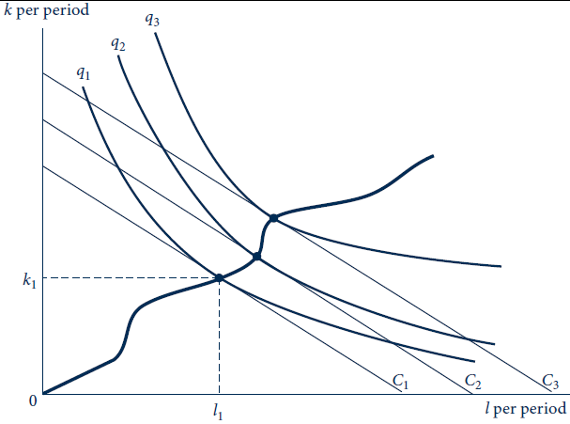
10.2 Firm’s Expansion Path
The firm’s expansion path is the locus of cost-minimizing tangencies. Assuming fixed input prices, the curve shows how inputs increase as output increases.

Slide 19
The Firm’s Expansion Path
The expansion path does not have to be a straight line
The use of some inputs may increase faster than others as output expands
Depends on the shape of the isoquants
The expansion path does not have to be upward sloping
If the use of an input falls as output expands, that input is an inferior input

Slide 20
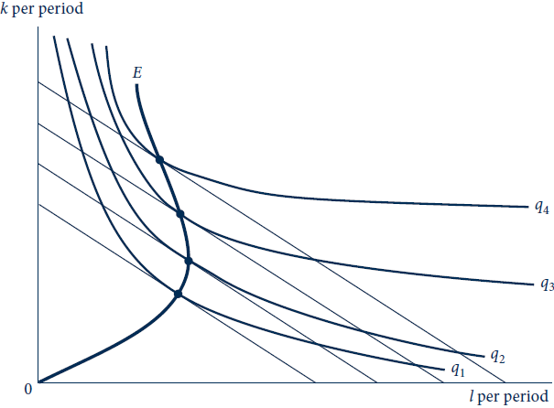
10.3 Input Inferiority
With this particular set of isoquants, labor is an inferior input because less l is chosen as output expands beyond q₂.

Slide 21
10.1 Cost Minimization
Cobb-Douglas production function: q = k ^{α} l ^{β}
The Lagrangian expression for cost minimization of producing q₀ is
ℒ = vk + wl + λ(q₀ - k ^{α} l ^{β})
First-order conditions for a minimum
∂ℒ /∂k = v - λαk ^{α-1}l ^{β}= 0
∂ℒ /∂l = w - λβk ^{α}l ^{β-1} = 0
∂ℒ/∂λ = q₀ - k ^{α} l ^{β} = 0

Slide 22
10.1 Cost Minimization
Dividing the first equation by the second gives us
This production function is homothetic
The RTS depends only on the ratio of the two inputs
The expansion path is a straight line

Slide 23
10.1 Cost Minimization
CES production function: q = (k ^{ρ} + l ^{ρ})^{γ/ρ}
The Lagrangian expression for cost minimization of producing q₀ is
ℒ = vk + wl + λ[q₀ - (k ^{ρ} + l ^{ρ})^{γ/ρ}]
First-order conditions for a minimum
∂ℒ /∂k = v - λ(γ/ρ)(k^{ρ} + l^{ρ})^{(γ-ρ)/ρ}(ρ)k^{ρ-1} = 0
∂ℒ /∂l = w - λ(γ/ρ)(k^{ρ} + l^{ρ})^{(γ-ρ)/ρ}(ρ)l^{ρ-1} = 0
∂ℒ /∂λ = q₀ - (k ^{ρ} + l ^{ρ})^{(γ-ρ)} = 0

Slide 24
10.1 Cost Minimization
Dividing the first equation by the second gives us
This production function is also homothetic

Slide 25
Total Cost Function
Total cost function
Shows that for any set of input costs and for any output level
The minimum cost incurred by the firm is
C = C(v,w,q)
As output (q) increases, total costs increase

Slide 26
Average and Marginal Cost Functions
Average cost function (AC)
Is found by computing total costs per unit of output
Marginal cost function (MC)
Is found by computing the change in total costs for a change in output produced

Slide 27
Graphical Analysis of Total Costs
To produce one unit of output we need
k₁ units of capital
And l₁ units of labor input
C(v,w,1) = vk₁ + wl₁
To produce m units of output
Assuming constant returns to scale
C(v,w,m) = vmk₁ + wml₁ = m(vk₁ + wl₁)
C(v,w,m) = m ⋅ C(v,w,1)

Slide 28
10.4 (a) Cost Curves in the Constant Returns-to-Scale Case
Total
costs
C
Output
In (a) total costs are proportional to output level.

Slide 29
10.4 (b) Cost Curves in the Constant Returns-to-Scale Case
Average and
marginal costs
AC=MC
Output per period
Average and marginal costs, as shown in (b), are equal and constant for all output levels.

Slide 30
Graphical Analysis of Total Costs
Suppose that total costs start out as concave and then becomes convex as output increases
One possible explanation for this is that there is a third factor of production that is fixed as capital and labor usage expands
Total costs begin rising rapidly after diminishing returns set in

Slide 31
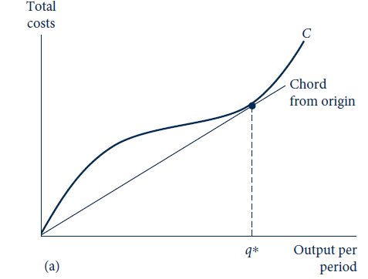
10.5 (a) Total, Average, and Marginal Cost Curves for the Cubic Total Cost Curve Case
If the total cost curve has the cubic shape shown in (a), average and marginal cost curves will be U-shaped.

Slide 32
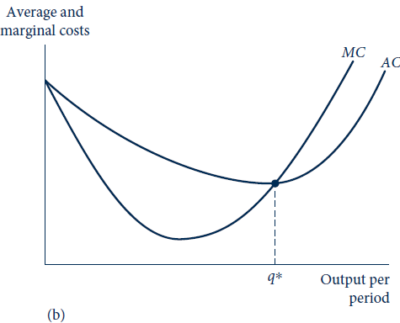
10.5 (b) Total, Average, and Marginal Cost Curves for the Cubic Total Cost Curve Case
If the total cost curve has the cubic shape shown in (a), average and marginal cost curves will be U-shaped. In (b) the marginal cost curve passes through the low point of the average cost curve at output level q*.

Slide 33
Shifts in Cost Curves
Cost curves
Are drawn under the assumption that input prices and the level of technology are held constant
Any change in these factors will cause the cost curves to shift

Slide 34
10.2 Some Illustrative Cost Functions
Fixed proportions
q = f(k,l) = min(αk,βl)
Production will occur at the vertex of the L-shaped isoquants (q = αk = βl)
C(w,v,q) = vk + wl = v(q/α) + w(q/β)
Because of constant returns-to-scale:
C(w,v,q) = qC(w,v,1)

Slide 35
10.2 Some Illustrative Cost Functions
Cobb-Douglas, q = f(k,l) = k ^{α}l ^{β}
Cost minimization requires that:
Substitute into the production function and solve for l, then for k

Slide 36
10.2 Some Illustrative Cost Functions
Cobb-Douglas
Now we can derive total costs as
Where B is a constant that involves only the parameters α and β

Slide 37
10.2 Some Illustrative Cost Functions
CES: q = f(k,l) = (k ^{ρ} + l ^{ρ})^{γ/ρ}
To derive the total cost, we would use the same method and eventually get

Slide 38
Properties of Cost Functions
Homogeneity
Cost functions are all homogeneous of degree one in the input prices
A doubling of all input prices will not change the levels of inputs purchased
Inflation will shift the cost curves up

Slide 39
Properties of Cost Functions
Nondecreasing in q, v, and w
Cost functions are derived from a cost-minimization process
Any decline in costs from an increase in one of the function’s arguments would lead to a contradiction

Slide 40
Properties of Cost Functions
Concave in input prices
Costs will be lower
When a firm faces input prices that fluctuate around a given level
Than when they remain constant at that level
The firm can adapt its input mix to take advantage of such fluctuations

Slide 41
10.6 Cost Functions Are Concave in Input Prices
Costs
C_{PSEUDO}
C(v’,w,q₀)
C(v’,w’,q₀)
w’
w
With input prices w’ and v’ , total costs of producing q₀ are C (v’, w’, q₀). If the firm does not change its input mix, costs of producing q₀ would follow the straight line C_{PSEUDO}. With input substitution, actual costs C (v’, w, q₀) will fall below this line, and hence the cost function is concave in w.

Slide 42
Properties of Cost Functions
Some of these properties carry over to average and marginal costs
Homogeneity
Effects of v, w, and q are ambiguous

Slide 43
Input Substitution
A change in the price of an input
Will cause the firm to alter its input mix
Recall the formula for elasticity of substitution

Slide 44
Input Substitution
Cost- minimization principle:
RTS(of l for k) = w/v at an optimum
Substituting, we get elasticity of substitution:
In the two-input case, s must be nonnegative
Large values of s indicate that firms change their input mix significantly if input prices change

Slide 45
Substitution with Many Inputs
Inputs (x₁, x₂, …, x_{n}) hired at competitive rental rates (w₁, w₂, …, w_{n})
s_{ij} , elasticity of substitution between any two inputs (x_{i} and x_{j})
s_{ij} is a more flexible concept than σ
It allows the firm to alter the usage of inputs other than x_{i} and x_{j} when input prices change

Slide 46
Quantitative Size of Shifts in Costs Curves
The increase in costs will be largely influenced by
The relative significance of the input in the production process
The ability of firms to substitute another input for the one that has risen in price

Slide 47
Technical Change
Improvements in technology
Lower cost curves
Total costs (constant returns to scale) are
C₀ = C₀(q,v,w) = qC₀(v,w,1)
The same inputs that produced one unit of output in period zero
Will produce A(t) units in period t
C_{t}(v,w,A(t)) = A(t)C_{t}(v,w,1)= C₀(v,w,1)

Slide 48
Technical Change
Total costs are given by
C_{t}(v,w,q) = qC_{t}(v,w,1) = qC₀(v,w,1)/A(t) = C₀(v,w,q)/A(t)
Total costs
Decrease over time at the rate of technical change

Slide 49
10.3 Shifting the Cobb–Douglas Cost Function
Cobb-Douglas cost function:
Assume α = β = 0.5, the total cost curve is greatly simplified

Slide 50
10.3 Shifting the Cobb–Douglas Cost Function
If v = 3 and w = 12, the relationship is
C = 480 to produce q =40
AC = C/q = 12
MC = ∂C/∂q = 12
If v = 3 and w = 27, the relationship is
C = 720 to produce q =40
AC = C/q = 18
MC = ∂C/∂q = 18

Slide 51
10.3 Shifting the Cobb–Douglas Cost Function
We are assuming that technical change takes an exponential form and the rate of technical change is 3 percent per year
Suppose the production function is
The cost function is then
If input prices remain the same, costs fall at the rate of technical improvement

Slide 52
Contingent Demand for Inputs
Contingent demand functions
For all of the firms inputs can be derived from the cost function
Shephard’s lemma
The contingent demand function for any input is given by the partial derivative of the total-cost function with respect to that input’s price

Slide 53
Contingent Demand for Inputs
Shepherd’s lemma
Is one result of the envelope theorem
The change in the optimal value
In a constrained optimization problem
With respect to one of the parameters
Can be found by differentiating the Lagrangian with respect to the changing parameter

Slide 54
Contingent Demand for Inputs

Slide 55
10.4 Contingent Input Demand Functions
Fixed proportions, C(v,w,q)=q(v/α+w/β)
Contingent demand functions are quite simple:

Slide 56
10.4 Contingent Input Demand Functions
Cobb-Douglas:
Contingent demand functions:

Slide 57
10.4 Contingent Input Demand Functions
CES:
The contingent demand functions:

Slide 58
The Elasticity of Substitution
Shepherd’s lemma
Can be used to derive information about input substitution directly from the total cost function

Slide 59
Short-Run, Long-Run Distinction
In the short run
Economic actors have only limited flexibility in their actions
Assume
The capital input is held constant at k₁
The firm is free to vary only its labor input
The production function becomes
q = f(k₁,l)

Slide 60
Short-Run Total Costs
Short-run total cost for the firm is
SC = vk₁ + wl
There are two types of short-run costs:
Short-run fixed costs are costs associated with fixed inputs (vk₁)
Short-run variable costs are costs associated with variable inputs (wl)

Slide 61
Short-Run Total Costs
Short-run costs
Are not minimal costs for producing the various output levels
The firm does not have the flexibility of input choice
To vary its output in the short run, the firm must use nonoptimal input combinations
The RTS will not be equal to the ratio of input prices

Slide 62
10.7 ‘‘Nonoptimal’’ Input Choices Must Be Made in the Short Run
k per period
SC₀
SC₁=C
SC₂
k₁
q₂
q₁
q₀
l₀
l₁
l₂
l per period
Because capital input is fixed at k, in the short run the firm cannot bring its RTS into equality with the ratio of input prices. Given the input prices, q₀ should be produced with more labor and less capital than it will be in the short run, whereas q₂ should be produced with more capital and less labor than it will be.

Slide 63
Short-Run Marginal and Average Costs
The short-run average total cost (SAC) function is
SAC = total costs/total output = SC/q
The short-run marginal cost (SMC) function is
SMC = change in SC/change in output = ∂SC/∂q

Slide 64
10.8 Two Possible Shapes for LR Total Cost Curves (a) Constant returns to scale
SC (k₂)
Total costs
C
SC (k₁)
SC (k₀)
Output
q₀
q₁
q₂
By considering all possible levels of capital input, the long-run total cost curve (C ) can be traced. In (a), the underlying production function exhibits constant returns to scale: In the long run, although not in the short run, total costs are proportional to output.

Slide 65
10.8 Two Possible Shapes for LR Total Cost Curves (b) Cubic total cost curve case
SC (k₂)
Total costs
SC (k₁)
C
SC (k₀)
Output
q₀
q₁
q₂
By considering all possible levels of capital input, the long-run total cost curve (C ) can be traced. In (b), the long-run total cost curve has a cubic shape, as do the short-run curves. Diminishing returns set in more sharply for the short-run curves, however, because of the assumed fixed level of capital input.

Slide 66
Short-Run and Long-Run Cost Curves
Long-run total costs (C)
Are always less than short-run total costs (SC)
Except at that output level (q₁) for which the assumed fixed capital input (k₁) is appropriate to long-run cost-minimization
For q₁: SC = C
For all other quantities: SC > C

Slide 67
Short-Run and Long-Run Costs
At the minimum point of the AC curve:
The MC curve crosses the AC curve
MC = AC at this point
The SAC curve is tangent to the AC curve
SAC (for this level of k) is minimized at the same level of output as AC
SMC intersects SAC also at this point
AC = MC = SAC = SMC

Slide 68
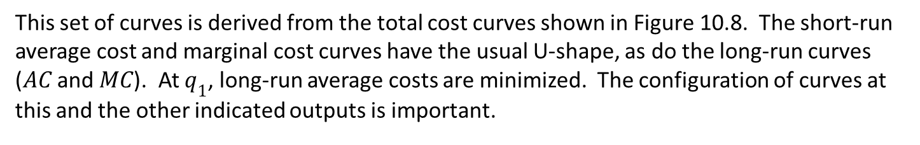
10.9 Average and Marginal Cost Curves for the Cubic Cost Curve Case
Costs
SMC (k₂)
SAC (k₂)
SMC (k₀)
SAC (k₀)
MC
AC
SMC (k₁)
SAC (k₁)
q₀
q₁
q₂
Output
per period
This set of curves is derived from the total cost curves shown in Figure 10.8. The short-run average cost and marginal cost curves have the usual U-shape, as do the long-run curves ($AC$ and $MC$). At $q_{1}$, long-run average costs are minimized. The configuration of curves at this and the other indicated outputs is important.

Slide 69
10.5 Envelope Relations and Cobb-Douglas Cost Functions
Cobb-Douglas: q=k^{α}l^{β}
Hold capital constant at k₁
In the short run: q=k₁^{α}l^{β} or l=q^{1/β}k₁^{-α/β}
Total costs are:
SC(v,w,q,k₁) = vk₁ + wl = vk₁ + wq^{1/β}k₁^{-α/β}
To derive long-run costs, choose k to minimize total costs
∂ SC(v,w,q,k)/∂k = v + [-α/β] wq^{1/β}k₁^{-(α+β)/β} = 0
Solving for k: C(v,w,q) = βq^{1/(α+β)}v^{α/(α+β)}w ^{β/(α+β)}

Slide 70

10.1 Difference Between Short-Run and Long-Run Total Cost, k=80
q | C = 12q | SC=240+3q²/20
10 | 120 | 255
20 | 240 | 300
30 | 360 | 375
40 | 480 | 480
50 | 600 | 615
60 | 720 | 780
70 | 840 | 975
80 | 960 | 1,200

Slide 71
10.2 Unit Costs in the Long-Run and the Short-run, k=80
q | AC | MC | SAC | SMC
10 | 12 | 12 | 25.5 | 3
20 | 12 | 12 | 15 | 6
30 | 12 | 12 | 12.5 | 9
40 | 12 | 12 | 12 | 12
50 | 12 | 12 | 12.3 | 15
60 | 12 | 12 | 13 | 18
70 | 12 | 12 | 13 | 21
80 | 12 | 12 | 15 | 24

Slide 72
The Translog cost function
The translog function with two inputs
Implicitly assumes constant returns to scale
Homogeneous of degree 1 in input prices if: a₁ + a₂ = 1 and a₃ + a₄ + a₅ = 0
Includes the Cobb–Douglas as the special case a₃ = a₄ = a₅ = 0

Slide 73
The Translog cost function
The translog function with two inputs
Input shares – easy to compute:
s_{i} = (∂ lnC)/(∂ ln w_{i})
Elasticity of substitution
Allen elasticity of substitution
A_{kl}=1+a₅/s_{k}s_{l}

Slide 74
The Translog cost function
Many-input translog cost function
n inputs, each with a price of w_{i}(i = 1,…, n)
Constant returns to scale

Slide 75
The Translog cost function
Many-input translog cost function
Homogeneous of degree 1 in the input prices if
Input shares take the linear form
Elasticity of substitution between any two inputs

